Slide 1
CISC2003 OOP AND DATA STRUCTURES
1
Lab 1
Notes:
Chapter 1 - 1

Slide 2
Lab Introduction
2
Notes:
Chapter 1 - 2

Slide 3
TA Information
3
Name: Wu Qingtian（吴庆甜）
E-Mail: yc07452@umac.mo
Office: E11-2016
Tips: There are other two TAs for lab instruction. We will take turns in lab.
Notes:
Chapter 1 - 3

Slide 4
Lab Content
4
Review the lectures
In-Class Practice
Reference codes will be provided at the lab
Exercise(10%) (Lab attendance included)
Submission deadline: 11:50 p.m. this Wednesday.
Reference codes for exercises of previous lab will be provided on UMMoodle
Late submission 10% deduction per day.
Notes:
Chapter 1 - 4

Slide 5
Java Compiler
5
We suggest use Drjava as compiler.
Other compiler: Eclipse, MyEclipse, IDEA. etc. (Require java JDK and JRE)
Notes:
Chapter 1 - 5

Slide 6
Lab 1
6
Notes:
Chapter 1 - 6

Slide 7
Outline
7
Get familiar with the Java Compiler;
Get familiar with basic Java programming technique.
Notes:
Chapter 1 - 7

Slide 8
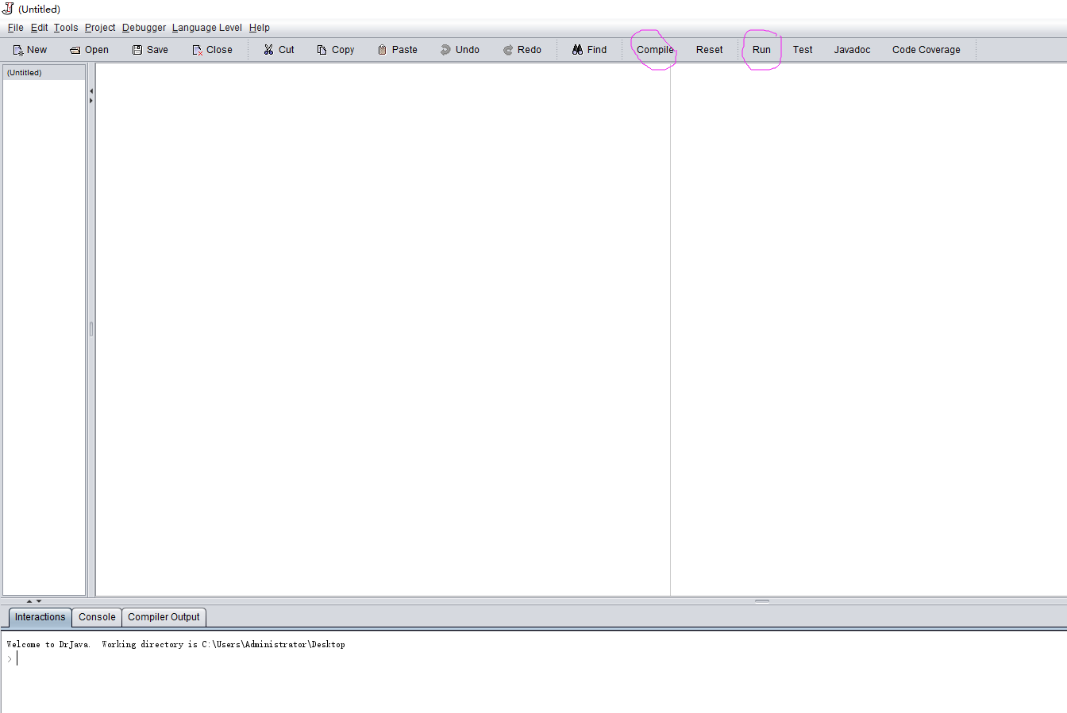
DrJava
8
Files Pane
Definitions Pane
Interactions Pane
Notes:
Chapter 1 - 8

Slide 9
DrJava
9
Implement your program:
Input the code in the Interaction panes and implement directly
Create a new .java file, input code, compile and run
Notes:
Chapter 1 - 9

Slide 10
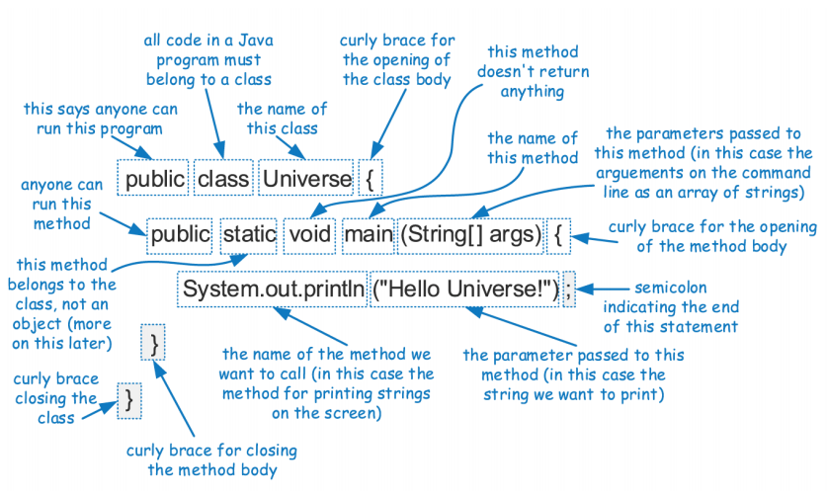
First Program: Hello Universe
10
Notes:
Chapter 1 - 10

Slide 11
Basic Grammar
11
case sensitive
class name: capitalize the first letter; If the class name consists of several words, the first letter of each word should be capitalized. (Java Basics ,slide 9)
method name: start with a lowercase letter; If the method name contains several words, capitalize the first letter of each subsequent word. (Java Basics ,slide 9)
file name: must be the same as the class name
Notes:
Chapter 1 - 11

Slide 12
Example1: Output
12
public class Universe {
public static void main(String[] args) {
int x=10;
int y=25;
int z=x+y;
System.out.println("Sum of x+y = " + z); //output
}
}
Try: consider why we should use +z, not z?
Notes:
Chapter 1 - 12

Slide 13
public class Universe {
public static void main(String[] args) {
print();
}
public static void print() {
int x=10;
int y=25;
int z=x+y;
System.out.println("Sum of x+y = " + z);
}
}
Cannot make a static reference to the non-static method print() from the type Universe
Example2: Start a new method
13
Try: what would happen if static is removed
Notes:
Chapter 1 - 13

Slide 14
Example3: Start a different class
14
public class Universe {
public static void main(String[] args) {
NewClass A;
A=new NewClass();
System.out.println(A.a);
}
public static class NewClass { //this class is inside the class Universe
int a;
public NewClass() {
a=1;
} //constructor
}
}
Try: start a new class in a different file, instead of inside the class
Notes:
Chapter 1 - 14

Slide 15
Example4: Java input
15
Scanner class
in package util
input is obtained by Space, Tab and Enter,
and Enter
BufferedReader class
in package io
input can include Space
Notes:
Chapter 1 - 15

Slide 16
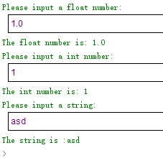
Example4(1): Java input - Scanner
16
import java.util.*;
public class HelloJava {
public static void main(String[] args) {
Scanner in = new Scanner(System.in); //Scanner class
System.out.println("Please input a float number:");
float a = in.nextFloat(); //input float data
System.out.println("The float number is: " + a);
System.out.println("Please input a int number: ");
int b = in.nextInt(); //input int data
System.out.println("The int number is: " + b);
System.out.println(" Please input a string: "); //not space in the middle
Scanner str = new Scanner(System.in);
System.out.println("The string is :" + str.next());
}
}
Notes:
Chapter 1 - 16

Slide 17
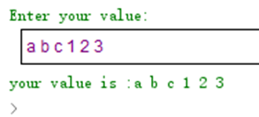
Example4(2): Java input - BufferedReader
17
import java.io.*;
public class HelloJava {
//one class needs to have a main() method
//arguments are passed using the text field below this editor
public static void main(String[] args) throws IOException { //needed while input
BufferedReader br = new BufferedReader(new InputStreamReader(System.in));
String str = null;
System.out.println("Enter your value:");
str = br.readLine();
System.out.println("your value is :"+str);
}
}
Notes:
Chapter 1 - 17

Slide 18
Practice
18
Write a short Java method, isMultiple, that takes two long values, n and m, and returns true if and only if n is a multiple of m, that is, n = m*i for some integer i.
m is fixed and given by yourself.
Repeatedly input n, and output the result.
Program exits when n is 0.
Example: m=2
input n=4, output ‘True’
input n=5, output ‘False’
input n=0, output exits.
Notes:
Chapter 1 - 18

Slide 19
Exercise
19
Develop a Java program to determine whether a given integer is a power of two.
Example1:
Input: 1
Output: true
Example2:
Input: 16
Output: true
Example3:
Input: 218
Output: false
[Submission Guidelines]
Please upload two files: source code file(s) in *. java, and its pdf version.
Do not copy codes from others, or both you two will lose scores.
Submission deadline: 11:50 pm this Wednesday.
Notes:
Chapter 1 - 19

